Slide 1
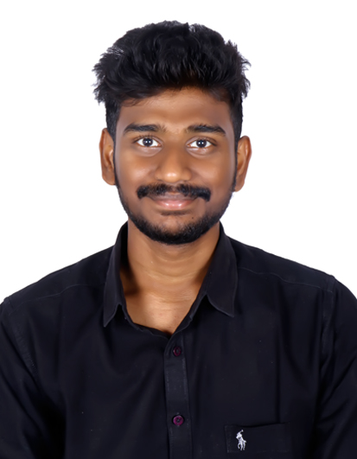
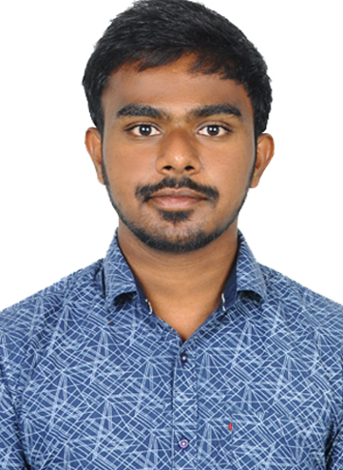
GANESH FINANCE LIMITED
TEAM:
Sankeerth M
Vardhan N

Slide 2




TECH STACK - FRONT END

Slide 3







TECH STACK - BACK END

Slide 4
OBJECTIVES
CUSTOMER
Enable customers to apply/withdraw loan applications.
Enable customers to view all his loan applications and their status.
Enable customer to reset password.
MANAGER
Enable manager to view all the loan applications and approve/reject applications.
Confirmation notifications through mails.
CLERK
Enable clerk to create a new customer account.
Enable clerk to create a loan application for existing customer.
Enable clerk to view applications.
Enable online loan application process for users.
Seamless document upload and retrieval.
Easily access and view data by applying filters and sorting options.
Enable users to calculate EMI in a user friendly approach.

Slide 5
FUTURE SCOPE
Incorporate Optical Character Recognition (OCR) and Natural Language Processing (NLP) technologies to automatically verify and extract information from uploaded documents, reducing manual errors and processing time
Inclusion of Chatbots and Virtual Assistants
implementation of 4 tier architecture in backend
Enhancement of User Experience (UX/UI)
Incorporate Blockchain for Security and Transparency

Slide 6
Thank you

